Slide 1
TRUE NORTH EXERCISE
Mark Core

Slide 2
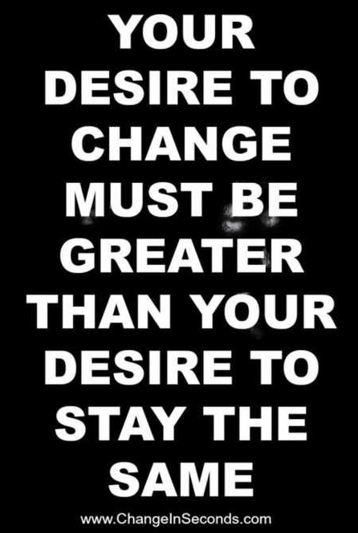

Slide 3
True North Defined
True north, your directional compass, is a term used to describe the “ideal” or state of perfection your business should be continually striving toward.

Slide 4
True North Defined
It refers to what you should do, not what you could do. It defines a vision of the ideal value proposition from both the needs of your targeted customer and the offering you provide as a Hereford breeder.

Slide 5
Your True North
Once you have your True North directional compass established, it will serve as a tool for which you reference in every management and investment decision. It will also provide you context for all marketing content.

Slide 6
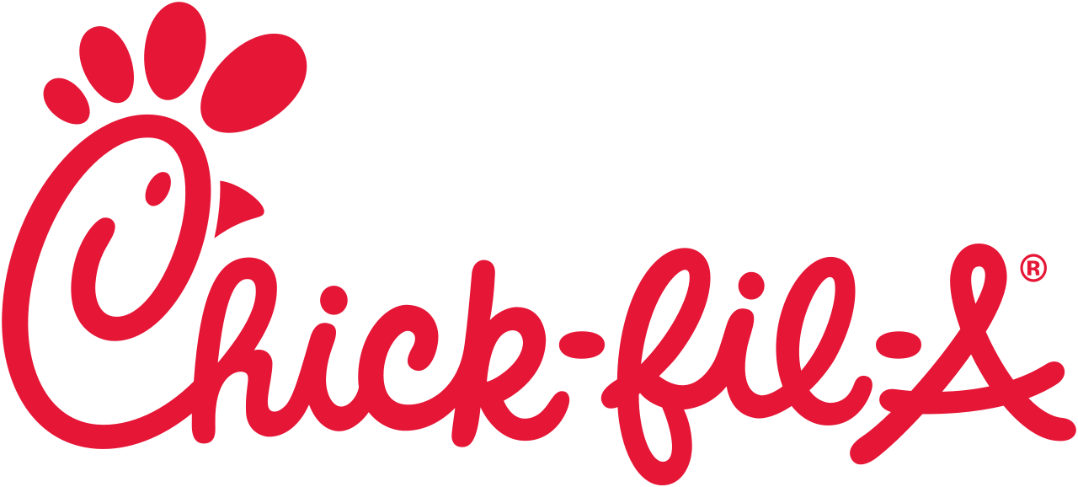

Slide 8
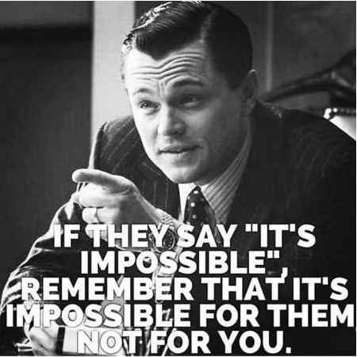

Slide 9
Notes:
JJ Video

Slide 10
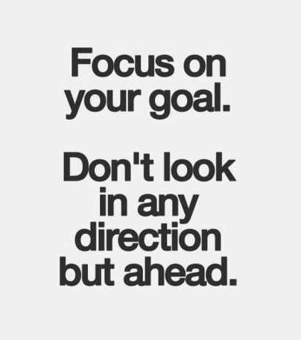

Slide 11
Today
Goals by 2022
Total Market
Bulls
________________
________________
8,000
Show Heifers
________________
________________
1,800
Retail Beef
________________
________________
25,714,687,680 lbs.
Semen
________________
________________
176,114 straws

Slide 15
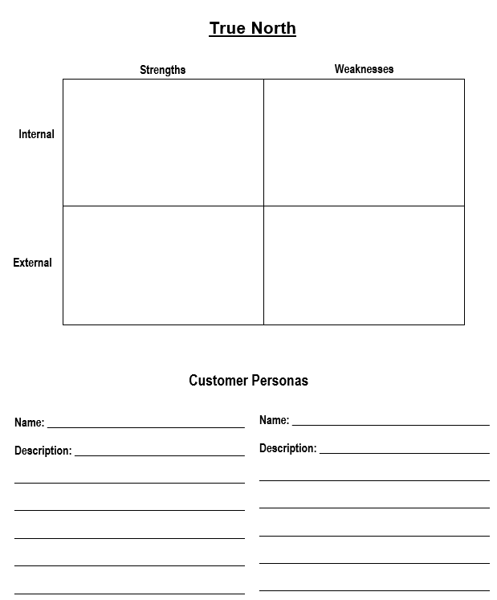
S.W.O.T.

Slide 16
Leverage
Recognize
Chase
React

Slide 17
